Slide 1
4.1) Expanding ${\left(1+x\right)}^{n}$

Slide 2
Worked example
Your turn
Find the binomial expansion of:
$${\left(1+x\right)}^{4}$$
$${\left(1−2x\right)}^{5}$$
Find the binomial expansion of:
$${\left(1+3x\right)}^{6}$$
$$1+18x+135x^{2}+540x^{3}+1215x^{4}+1458x^{5}+729x^{6}$$

Slide 3
Worked example
Your turn
Find the first four terms in the binomial expansion of:
$$\frac{1}{1+x}$$
$$\frac{1}{{\left(1−x\right)}^{3}}$$
Find the first four terms in the binomial expansion of:
$$\frac{1}{{\left(1+x\right)}^{2}}$$
$$1−2x+3x^{2}−4x^{3}+…$$

Slide 4
Worked example
Your turn
Find the first four terms in the binomial expansion of:
$$\frac{1}{1+2x}$$
$$\frac{1}{{\left(1−3x\right)}^{4}}$$
Find the first four terms in the binomial expansion of:
$$\frac{1}{{\left(1+4x\right)}^{3}}$$
$$1−12x+96x^{2}−640x^{3}+…$$

Slide 5
Worked example
Your turn
Find the first four terms in the binomial expansion of:
$$\sqrt{1+x}$$
$$\sqrt[4]{1−x}$$
Find the first four terms in the binomial expansion of:
$$\sqrt[3]{1−x}$$
$$1−\frac{1}{3}x−\frac{1}{9}x^{2}−\frac{5}{81}x^{3}+…$$

Slide 6
Worked example
Your turn
Find the first four terms in the binomial expansion of:
$$\sqrt{1+6x}$$
$$\sqrt{1−4x}$$
Find the first four terms in the binomial expansion of:
$$\sqrt{1−2x}$$
$$1−x−\frac{x^{2}}{2}−\frac{x^{3}}{2}+…$$

Slide 7

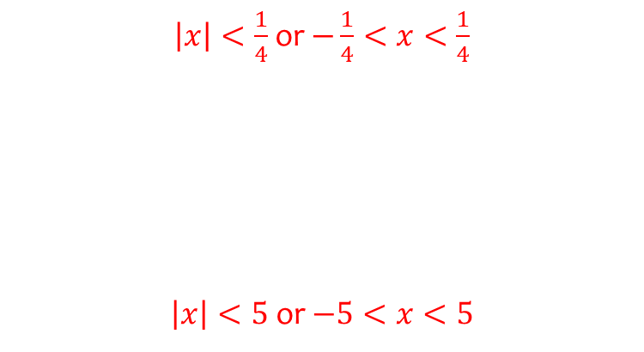
Worked example
Your turn
State when the binomial expansion is valid:
$$\frac{1}{1+2x}$$
$$\frac{1}{{\left(1−3x\right)}^{4}}$$
$${\left(1+5x\right)}^{\frac{3}{2}}$$
$$\frac{1}{\sqrt{1+\frac{x}{7}}}$$
State when the binomial expansion is valid:
$$\frac{1}{{\left(1+4x\right)}^{3}}$$
$$\sqrt{1−\frac{x}{5}}$$
$\left|x\right|<\frac{1}{4}$ or $−\frac{1}{4}<x<\frac{1}{4}$
$\left|x\right|<5$ or $−5<x<5$

Slide 8

Worked example
Your turn
State when the binomial expansion is valid:
$$\frac{2−x}{\sqrt{1+3x}}$$
$$\frac{5+x}{{\left(1−2x\right)}^{4}}$$
$${\left(1+5x\right)}^{\frac{3}{2}}\sqrt{1−\frac{x}{4}}$$
State when the binomial expansion is valid:
$$\frac{2+x}{\sqrt{1+5x}}$$
$${\left(1−3x\right)}^{\frac{5}{3}}\sqrt[4]{1+\frac{x}{2}}$$
$\left|x\right|<\frac{1}{5}$ or $−\frac{1}{5}<x<\frac{1}{5}$
$\left|x\right|<\frac{1}{3}$ or $−\frac{1}{3}<x<\frac{1}{3}$

Slide 9
Worked example
Your turn
By substituting $x=0.07$ into the binomial expansion for $\sqrt{1−4x}$, find a decimal approximation to $\sqrt{2}$
By substituting $x=0.01$ into the binomial expansion for $\sqrt{1−2x}$, find a decimal approximation to $\sqrt{2}$
$$1.414213571…$$

Slide 10
Worked example
Your turn
By substituting $x=0.04$ into the binomial expansion for $\sqrt{1−4x}$, find a decimal approximation to $\sqrt{21}$ to 5 decimal places
By substituting $x=0.01$ into the binomial expansion for $\sqrt{1−8x}$, find a decimal approximation to $\sqrt{23}$ to 5 decimal places
$$4.79584$$

Slide 11
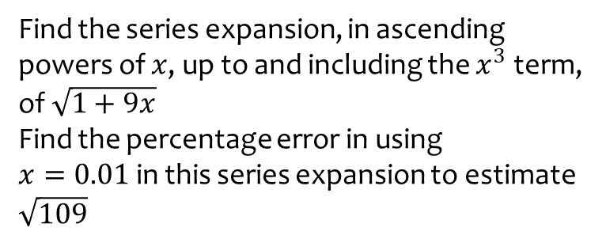
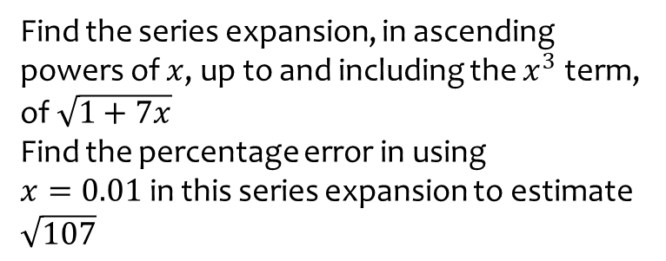
Worked example
Your turn
Find the series expansion, in ascending powers of $x$, up to and including the $x^{3}$ term, of $\sqrt{1+7x}$
Find the percentage error in using
$x=0.01$in this series expansion to estimate $\sqrt{107}$
Find the series expansion, in ascending powers of $x$, up to and including the $x^{3}$ term, of $\sqrt{1+9x}$
Find the percentage error in using
$x=0.01$in this series expansion to estimate $\sqrt{109}$
$0.003\%$ (3 dp)

Slide 12
Worked example
Your turn
Find the $x^{2}$ term in the series expansion of:
$$\frac{5−x}{\sqrt{1−3x}}$$
Find the $x^{2}$ term in the series expansion of:
$$\frac{2+x}{\sqrt{1+5x}}$$
$$\frac{65}{4}x^{2}$$

Slide 13
Worked example
Your turn
Find the first three terms in the series expansion of:
$$\sqrt{\frac{1+2x}{1−3x}}$$
Find the first three terms in the series expansion of:
$$\sqrt{\frac{1+x}{1−x}}, \left|x\right|<1$$
$$1+x+\frac{1}{2}x^{2}$$

Slide 14
Worked example
Your turn
Find the series expansion, in ascending powers of $x$, up to and including the $x^{2}$ term for:
$$\frac{6}{1−3x}−\frac{4}{1−2x}$$
Find the series expansion, in ascending powers of $x$, up to and including the $x^{2}$ term for:
$$\frac{6}{1+3x}−\frac{4}{1−5x}$$
$$2−38x−46x^{2}$$

Slide 15
Worked example
Your turn
In the expansion of ${\left(1+kx\right)}^{−3}$ the coefficient of $x$ is $12$. Find $k$
In the expansion of ${\left(1+kx\right)}^{−3}$ the coefficient of $x^{2}$ is $4$and $k>0$. Find $k$
In the expansion of ${\left(1+kx\right)}^{−4}$ the coefficient of $x$ is $20$. Find $k$
$$k=−5$$

